Slide 1


Hospital Patient Analysis
Analyzing patient data for optimized hospital operations and resource planning.
by Alaya Aba

Slide 2

Key Patient Metrics
10K
5
Total Patients
Total Diagnoses
44
Average Age

Slide 3

Patient Demographics & Top Diagnoses
Gender Distribution
Highest Diagnoses
Typhoid: 14.87% (highest)
Asthma: 14.40%
Ulcer: 14.39%
Other Diagnoses
Malaria: 14.36%
Diabetes: 14.07%
Hypertension: 14.01%
Male
Female
Stroke: 13.90%

Slide 4
Top 3 Diagnoses of Males and Females
Males
Females
Stroke (17%)
Typhoid (18%)
Ulcer (17%)
Malaria (17%)
Diabetes (16%)
Asthma (16%),

Slide 5
Data Quality: Issues & Solutions
Data Quality Issues
How to Stop Them
Inconsistent spellings/capitalization
Contact client for missing values
Incomplete cells in columns
Perform data cleaning
Ensure complete data entry
Verify correct client data entry

Slide 6

Age and Diagnosis Insights
Stroke Patients
Average age: 65 years (highest average)
Typhoid Admissions
1487 patients admitted

Slide 7
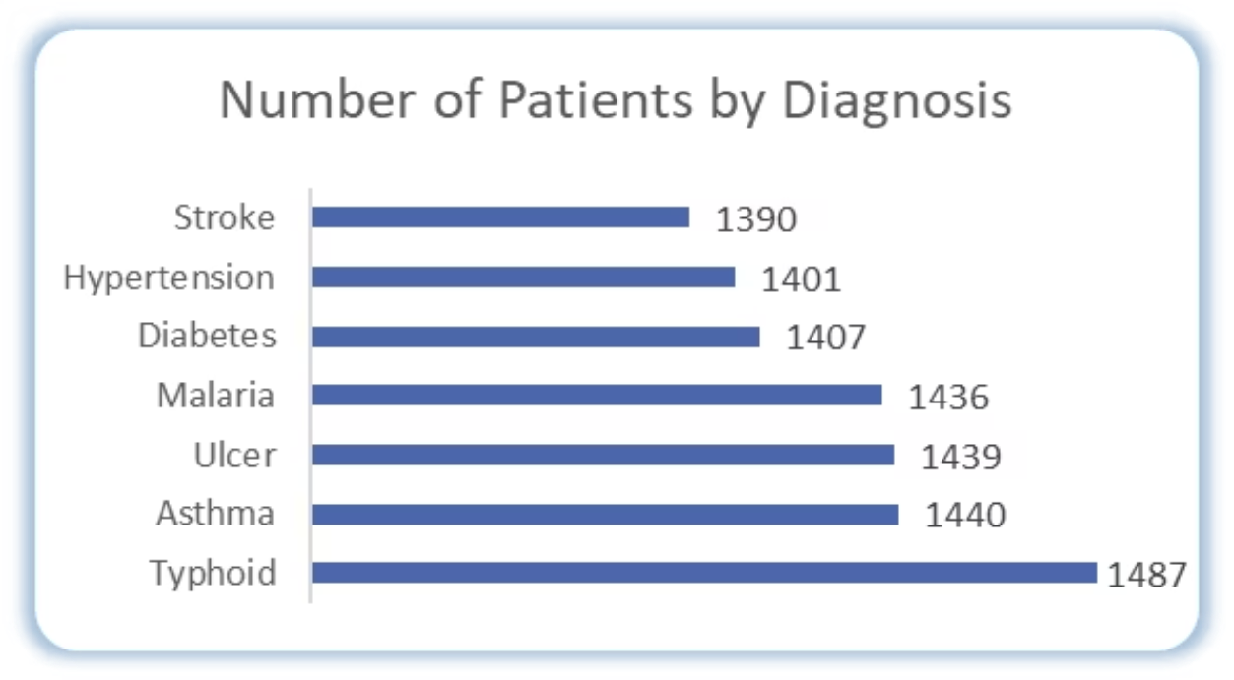
Number of Patients by Diagnosis

Slide 8
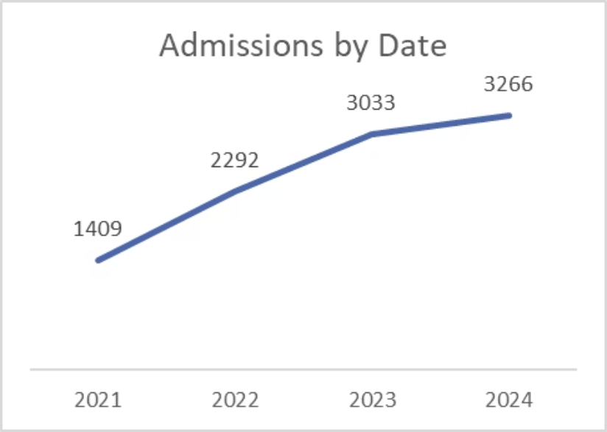
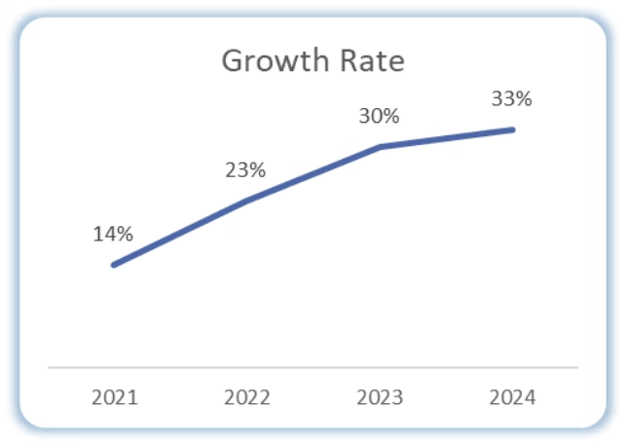
Number of Admissions by Date and Growth Rate

Slide 9
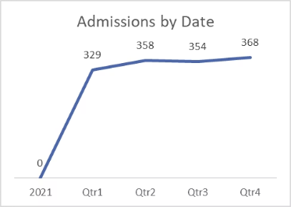
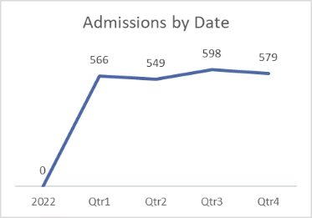
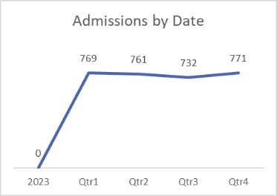
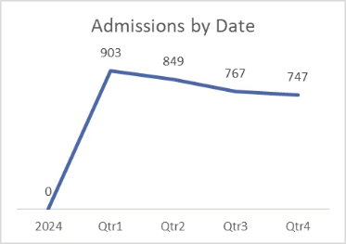
Admissions by Date - Per Quarter (yearly)
2021
2022
2023
2024

Slide 10
Average age of patients per diagnosis
Diagnoses
Average of Age
Asthma
35
Diabetes
53
Hypertension
58
Malaria
27
Stroke
65
Typhoid
30
Ulcer
43

Slide 11
Total number of Patients admitted per month
Months
Total Number of Patients
Jan
9%
Feb
8%
Mar
9%
Apr
8%
May
9%
Jun
8%
Jul
8%
Aug
8%
Sep
8%
Oct
9%
Nov
8%
Dec
8%

Slide 12
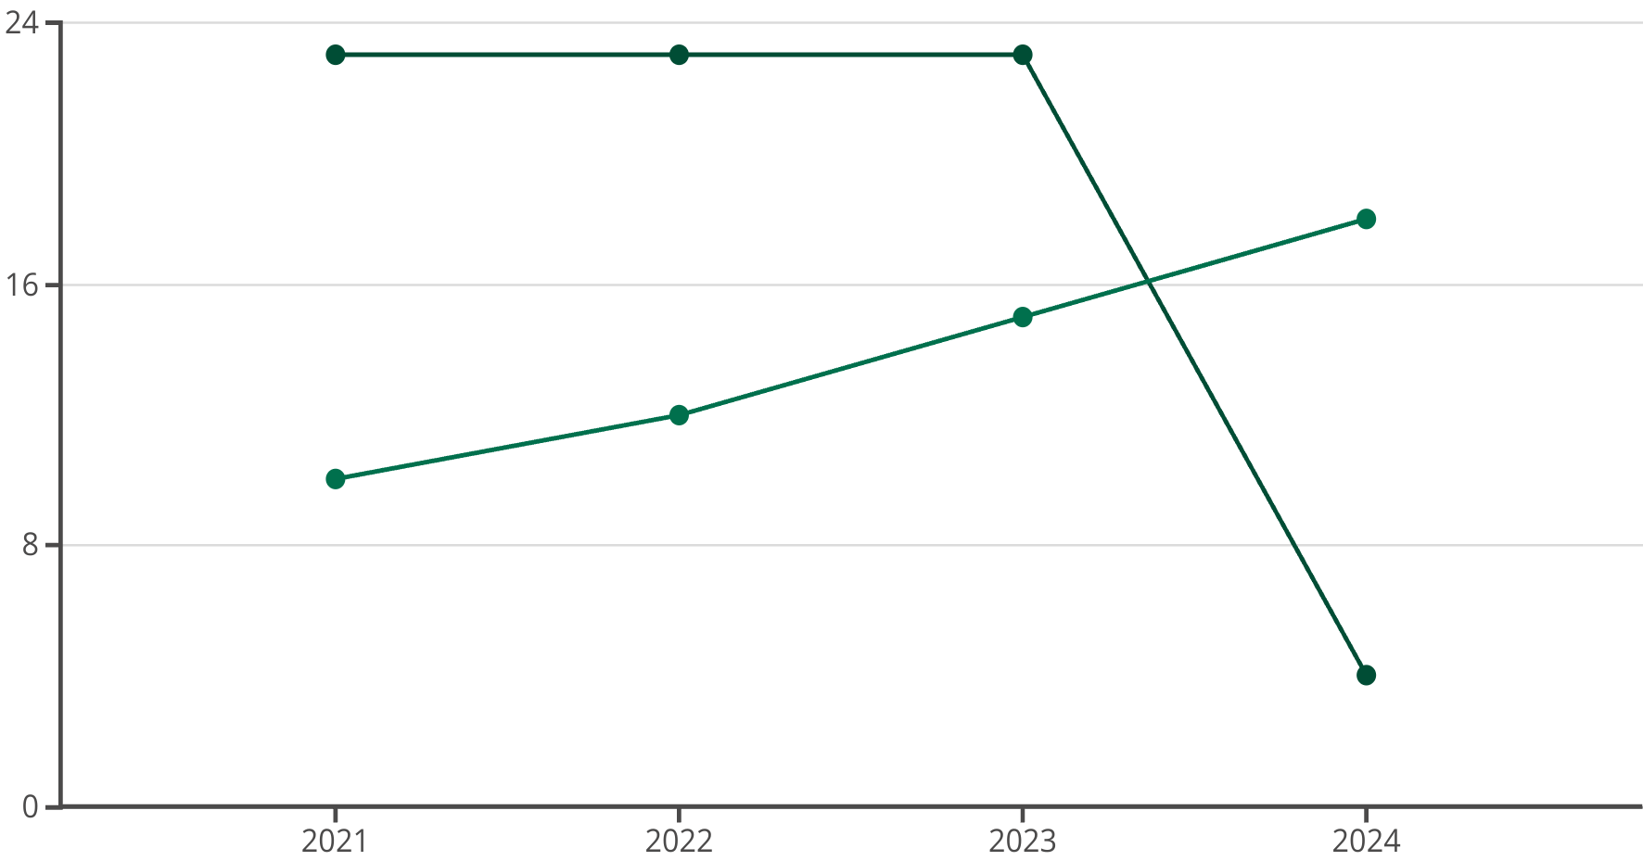
Diagnosis Trends Over Time
Typhoid
Stroke
Typhoid was common (23% average) until 2024, replaced by Stroke (18%), becoming least common (4%).

Slide 13

Resource Planning by Diagnosis
Medication and Vaccines
Procure more for typhoid, asthma, and stroke.
Environment and Oxygen
Clean environment, sufficient oxygen/medical air cylinders, and/or working gas plants.
Staff & Equipment
More specialists, beds, and constant maintenance (preventive and corrective).
Testing and Expansion
Purchase sufficient testing materials; consider facility expansion.

Slide 14
Recommendations & Community Programs
Key Recommendations
Community Health Programs
More resources for Typhoid, Asthma, Stroke.
Typhoid: Clean water, food, vaccines.
Procurement of resources in February, September and November in preparation for busy months.
Asthma: Education, care coverage, inhalers.
Stroke: Prevention, early recognition, affordable rehab.
Awareness programs with discounts.
Increasing community awareness for all of them and educating the public on how to solve/manage them.
Prepare for an increase in patients in 2025.
Targeted campaigns for male/female diagnoses within the age group of 31-40 with respect to top 3 diagnoses for both.
Provision of resources for 21-50 age group.

